Slide 1
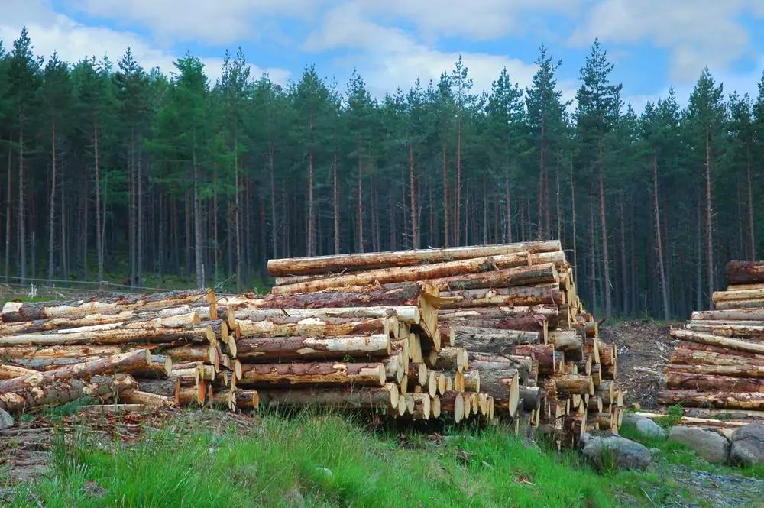
Timber in Future Housing: Stock Change and Climate Impacts in Germany to 2100
Biobased building team
Final presentation
Miaohan Tang
Jaehyun Soh
Weier Liu
Rio Aryapratama
Tanya Tsui
Alba Bruno
Sabrina Linsmaier
DdS Summer School
Singapore, 2025

Slide 2
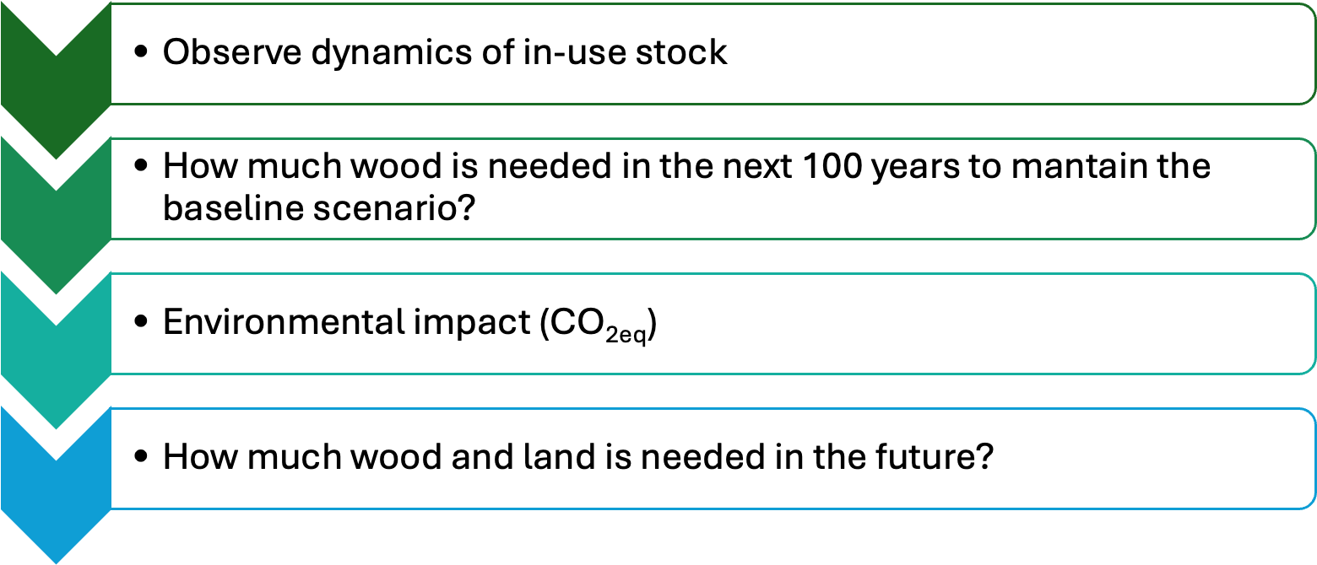
INTRODUCTION
RESEARCH QUESTIONs
Timber is often considered as a sustainable material due to its renewability, its ability to store carbon, and its potential as an alternative building material in construction.
The European Union (EU) has launched The New European Bauhaus that makes green transition in sustainable built environment.
The forest in Germany have the potential to supply wood for driving this transition towards wood use in the building sectors.

Slide 3
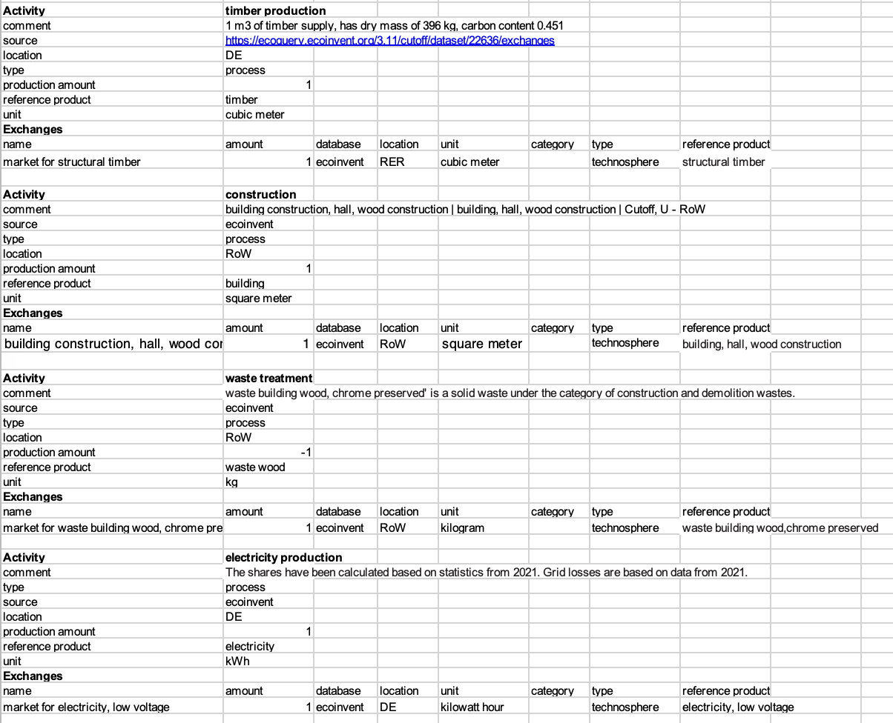
METHODS
LCA
FU: Annual housing service in Germany.
LCI: Statistics / Ecoinvent 3.10 cutoff database
LCIA: IPCC - GWP100
MFA
Stock-driven dynamic modelling: determining inflows from a stock scenario
One main process (construction) driving the model
Two different waste management strategies: recycling and incineration
*Germany does not practice landfilling

Slide 4
MFA
5
3
Recycling
0
f₀₁
1
f₁₂
2
f₂₃
f₃₄
4
f₄₅
Natural forest
ΔS₀
Forest Harvesting
Timber processing
Construction
ΔS₃
Waste management
6
f₄₆
Incineration
LCA
Parameters:
a = timber (m3) used in new construction (m2)
b = annual housing construction (m2) added to total housing stock
c = electricity consumption (kWh) used in total housing stock
d = solid waste (kg) produced by total housing stock
Ecoinvent i/o =
Waste treatment (kg)
1
Waste wood (kg)
Electricity production
d
Timber production (m3)
Construction (m2)
Housing lifecycle
1
Electricity
1
a
1
b
1
c
Timber (m3)
Building (m2)
Housing service

Slide 5
BASELINE SCENARIO
Existing timber stocks in German residential buildings are estimated based on the average timber material intensity (t/m²) across different building age cohorts.
The average per capita floor area (PCFA) in Germany is used (48 m²) and assumed to be constant throughout 2025-2100.
Using PCFA and projected population, the estimated timber building stocks are calculated over time from 2025-2100.
Assumed building lifetime: 70 years

Slide 6
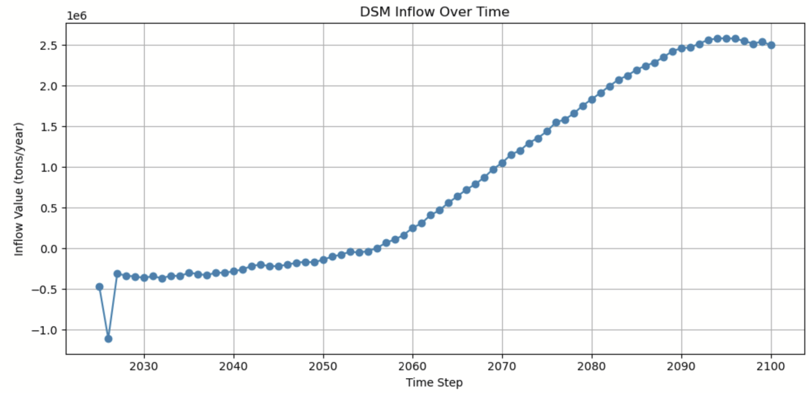
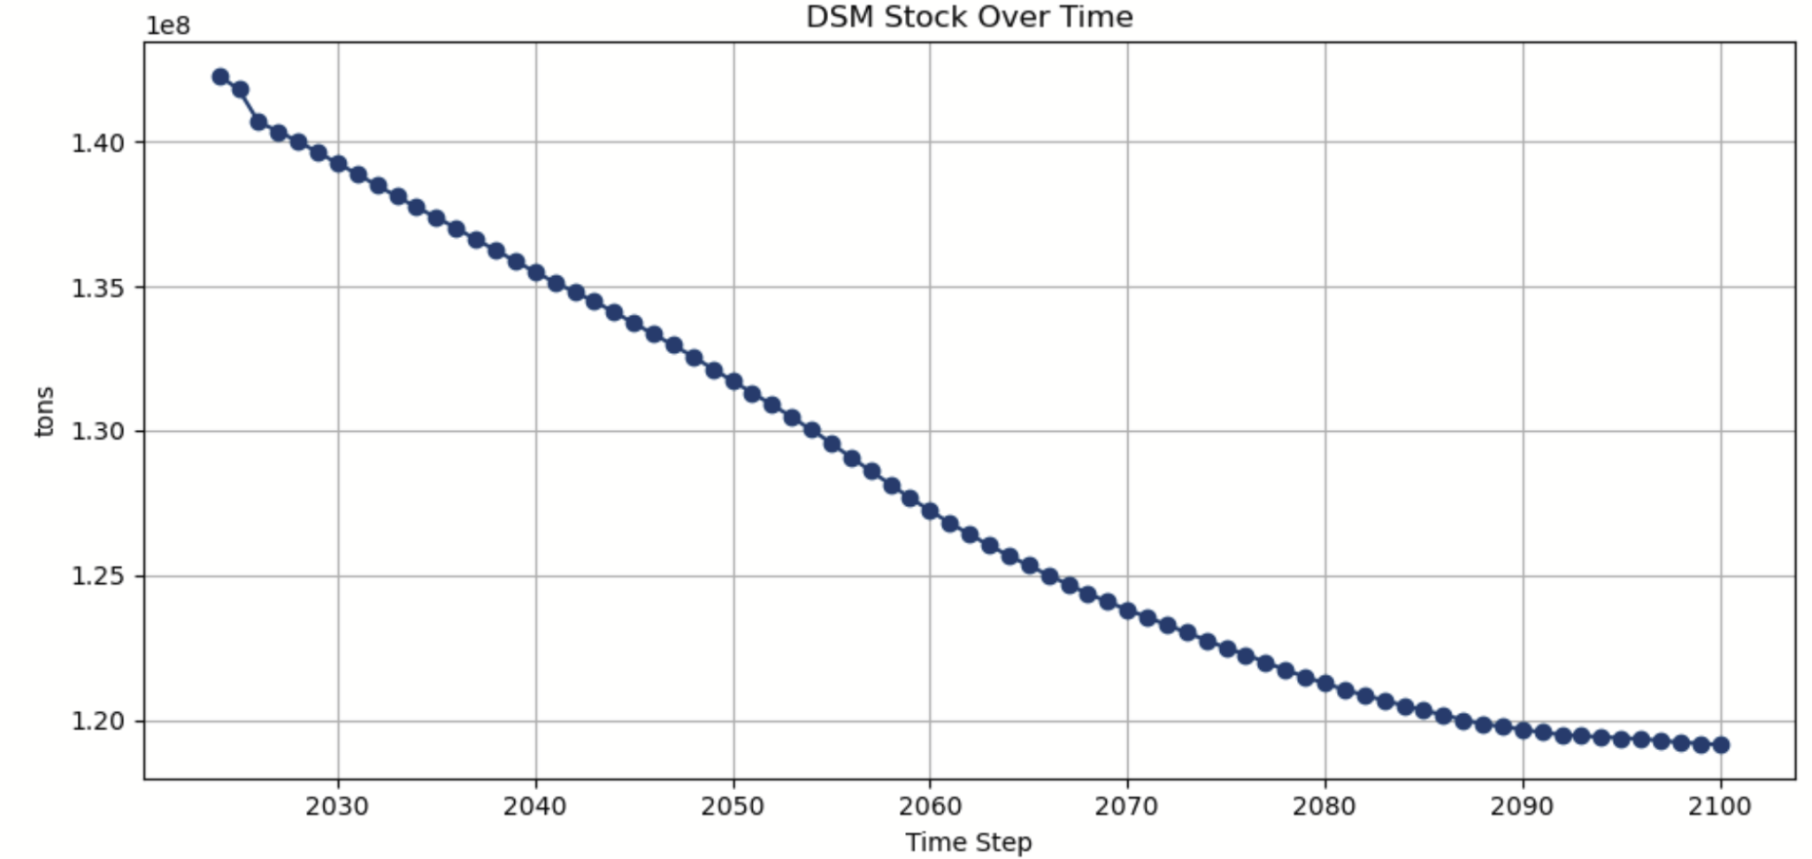
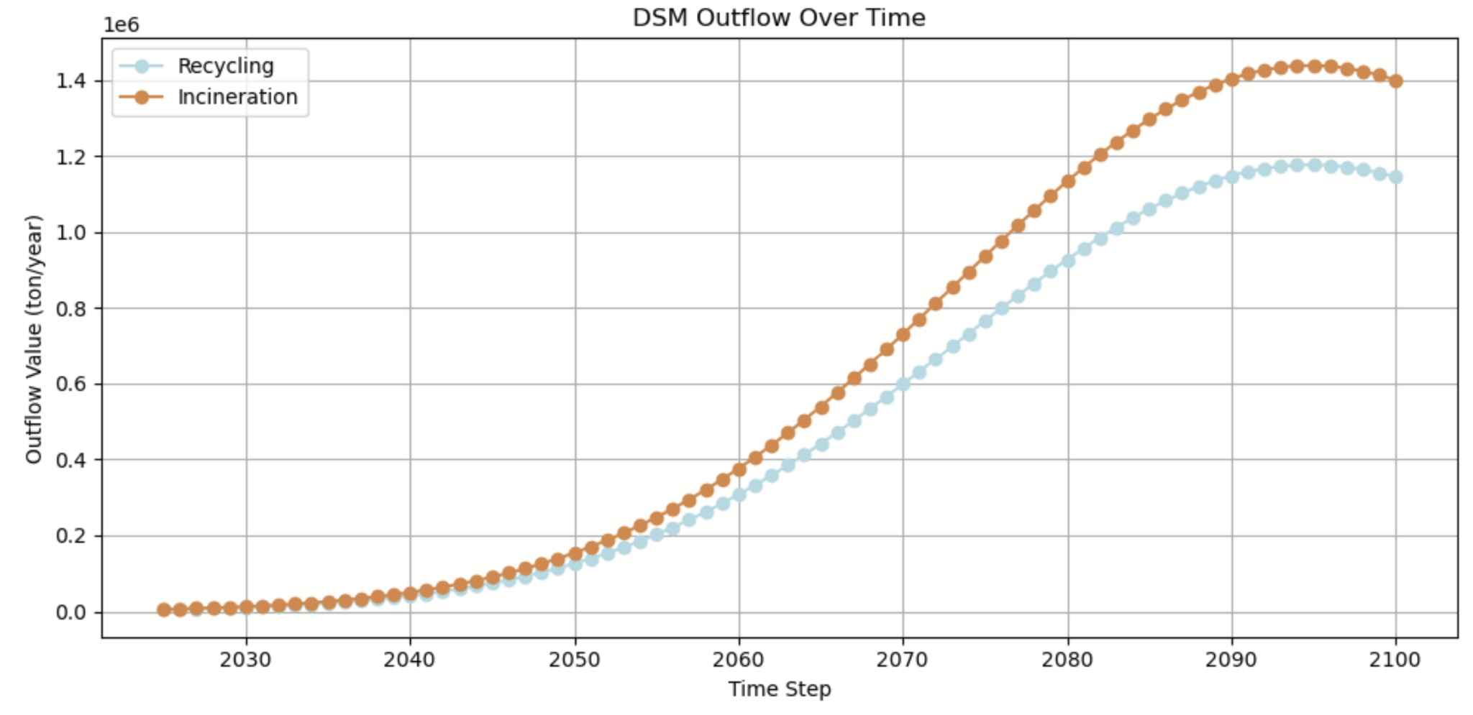
BASELINE SCENARIO - RESULTS
1e6
Inflow Over Time
1e8
Stock Over Time
1e6
Outflow Over Time

Slide 7
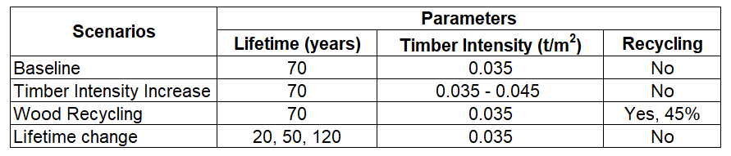
FUTURE SCENARIOS
European Initiative: New European Bauhaus
Assuming Timber intensity increase gradually from 0.035 t/m² in 2025 to 0.045 t/m² in year 2100.
Changing building lifetime to 20, 50 and 125 years
Introduce recycling rate of 45%.

Slide 8
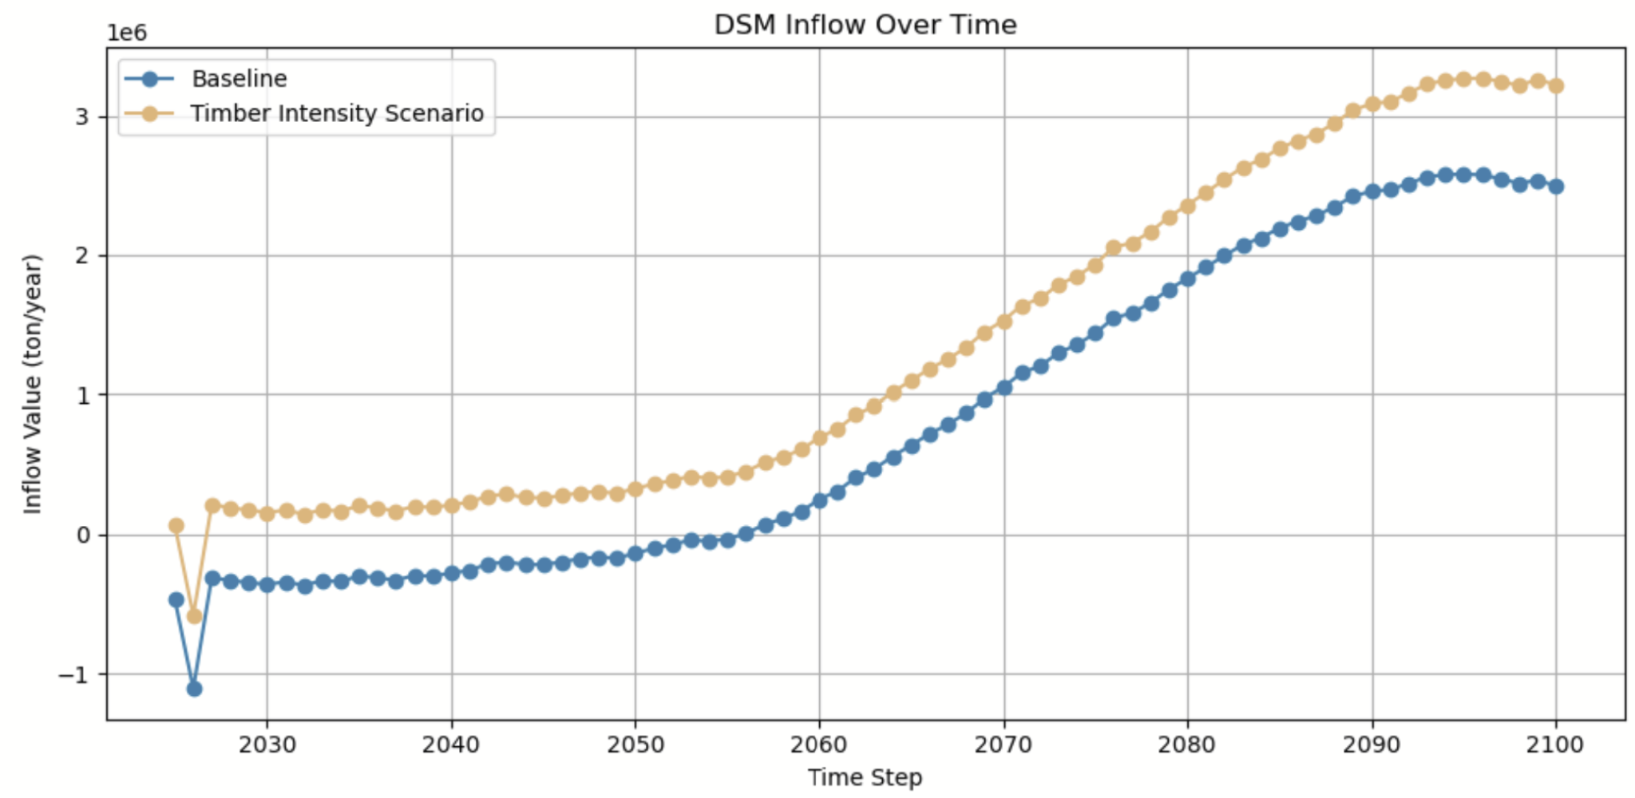
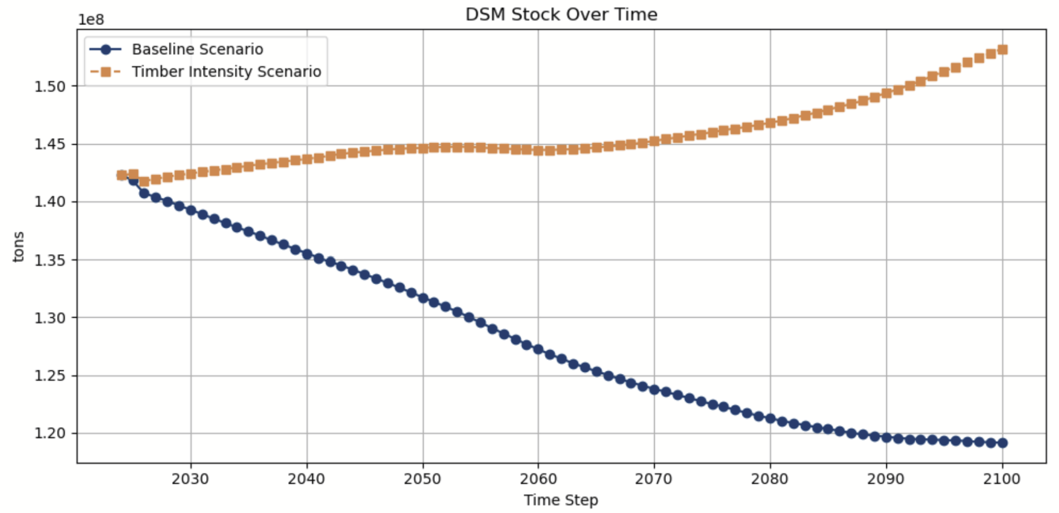
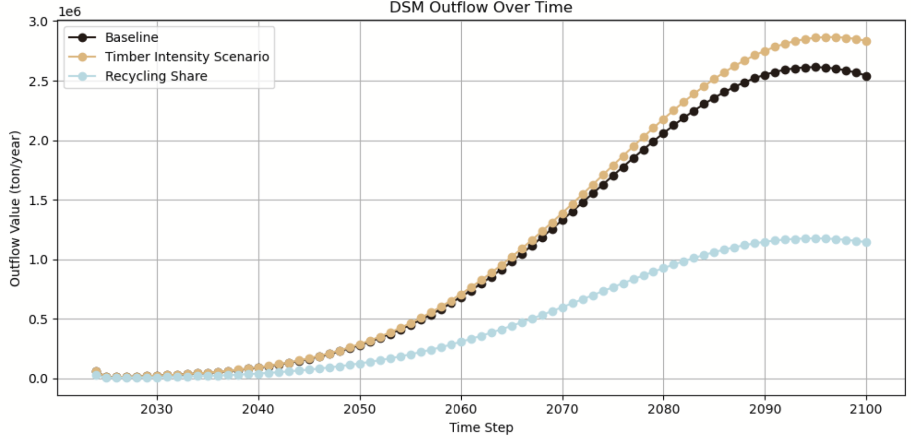
FUTURE SCENARIOS - RESULTS
1e6
Inflow Over Time
1e8
Stock Over Time
1e6
Outflow Over Time

Slide 9
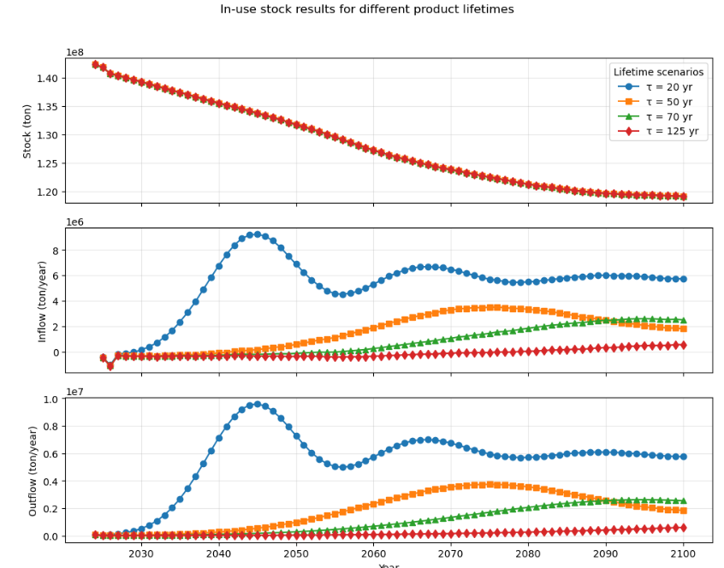
FUTURE SCENARIOS- RESULTS
Building lifetime- baseline 70 yr
Notes:
Shorter lifetimes result in higher and earlier inflows, and outflows

Slide 10
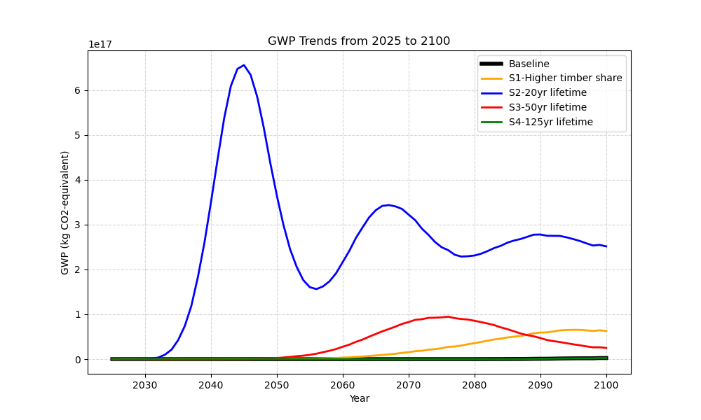
SCENARIOS COMPARISON FOR GWP

Slide 11
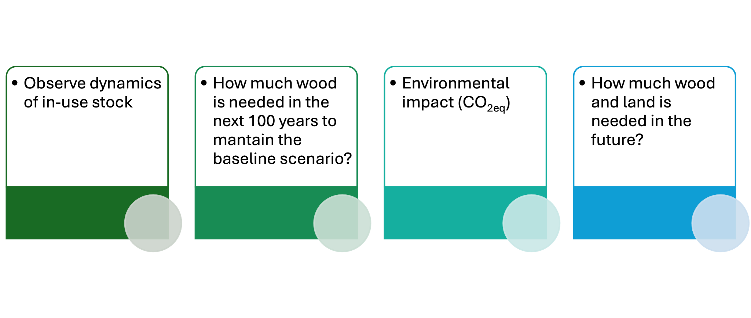
OVERALL COMMENT
✅
✅
✅
❌
69,622,551.73 tons (cumulative inflows, without recycling)
Possible with our data

Slide 12
IF WE HAD MORE TIME…
… we would merge our two jupyter notebooks and directly work with the MFA output
… we would like to incorporate age-cohorts for the in-use building stock
… we would combine the scenarios

Slide 13
6
f₂₃
3
f₃₅
f₅₆
Recycling
0
f₀₁
1
f₁₂
2
Natural forest
ΔS₀
Forest Harvesting
Timber processing
Construction
ΔS₃
5
7
Waste management
f₂₄
f₅₇
Incineration
4
Renovation
ΔS₄
f₄₅
✅
❌
Timber production
Construction
Incineration
✅
❌
❌
Timber
Building
❌
Energy
✅
✅
GHG

